Slide 1
CCS 6101:RESEARCH METHODS
Introduction
D
Y
E
G
D
AN
O
IV T
L
Dr. Jane.Kuria
K
IM
AT
HI
UN
ERSI
Y O
F T
EC
H
NO
Dedan Kimathi University of Technology

Slide 2
Learning Outcomes
Explain research design and the criteria to select one
Distinguish the different types of research designs.
Describe the different components of research design

Slide 3
Selection of a Research Design
Research designs are plans and the procedures for research that span the decisions from broad assumptions to detailed methods of data collection and analysis.
Plan involves several decisions
Designs involve which design to be used to study a topic.

Slide 4
Informing the Decision
Worldview assumptions the of the researcher
Procedures of inquiry (strategies)
specific methods of data
collection
analysis
interpretation
Selection of a research design is also based on the
nature of the research problem
issue being addressed
researchers’ personal experiences
audiences for the study.

Slide 5
Types of Research Design
Three types of designs are advanced: qualitative, quantitative, and mixed methods
The three methods are not as discrete as they appear.
They represent different ends of a continuum with mixed methods at the centre
Basic philosophical assumptions researchers bring to the study,
the types of research strategies
The specific methods employed in conducting these strategies

Slide 6
Qualitative Research
Exploring and understanding the meaning individuals or groups ascribe to a social or human problem
The process of research involves
emerging questions and procedures
data typically collected in the participant’s setting
data analysis inductively building from particulars to general themes,
the researcher making interpretations of the meaning of the data.
This form of inquiry support a way of looking at research that;
honours an inductive style,
a focus on individual meaning, and
the importance of rendering the complexity of a situation

Slide 7
Quantitative Research
A means for testing objective theories by examining the relationship among variables.
These variables are measured on instruments and numbered data can be analysed using statistical procedures.
Final written report has a set structure consisting of introduction, literature and theory, methods, results, and discussion.
This form of inquiry have assumptions about
testing theories deductively
building in protections against bias
Controlling for alternative explanations
being able to generalize and replicate the findings.

Slide 8
Mixed Methods
An approach to inquiry that combines or associates both qualitative and quantitative forms.
It involves philosophical assumptions;
use of qualitative and quantitative approaches
mixing of both approaches in a study.
It also involves the use of both approaches in tandem so that the overall strength of a study is greater than either qualitative or quantitative research

Slide 9
Design Components
In planning a study, researchers need to think through;
the philosophical worldview assumption
the strategy of inquiry that is related to this worldview
specific methods or procedures of research that translate the approach into practice.

Slide 10
Philosophical Worldview
Philosophical ideas remain largely hidden in research but still influence the practice of research.
A proposal might include a section that addresses the following:
The philosophical worldview proposed in the study
A definition of basic considerations of that worldview
How the worldview shaped their approach to research

Slide 11
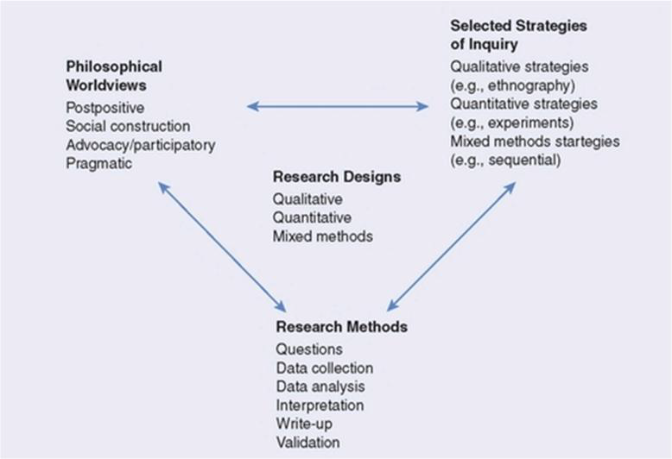
A framework for Design
The Interconnection of Worldviews, Strategies of Inquiry, and Research Methods.
Worldview as meaning “a basic set of beliefs that guide action”
Others have called them paradigms epistemologies and ontologies

Slide 12
Postpositivist Worldview
Postpositivist assumptions hold true more for quantitative research than qualitative research.
Also known as scientific method, positivist/postpositivist research, empirical science.
Postpositivism represents the thinking after positivism challenging the traditional notion of the absolute truth of knowledge.
It recognizing that we cannot be “positive” about our claims of knowledge when studying the behaviour and actions of humans.

Slide 13
Postpositivist Worldview
Postpositivist assumptions hold true more for quantitative research than qualitative research.
Reductionistic: reduces the ideas into a small, discrete set of ideas to test, such as the variables that comprise hypotheses and research questions.
The scientific method, the accepted approach to research by postpostivists,
begins with a theory,
collects data that either support or refutes the theory
makes necessary revisions before additional tests are made.

Slide 14
Key assumptions of Postpositivist Worldview
Knowledge is conjectural (and antifoundational)—absolute truth can never be found.
Research is the process of making claims and then refining or abandoning some of them for other claims more strongly warranted.
Data, evidence, and rational considerations shape knowledge
Research seeks to develop relevant, true statements, ones that can serve to explain the situation of concern or that describe the causal relationships of interest.
Being objective is an essential aspect of competent inquiry.

Slide 15
The Social Constructivist Worldview
It holds assumptions that individuals seek understanding of the world in which they live and work
Individuals develop subjective meanings of their experiences.
The meanings are varied and multiple, leading the researcher to look for the complexity of views
Questions become broad and general so that the participants can construct the meaning of a situation in interactions

Slide 16
Assumptions of Social Constructivist Worldview
Meanings are constructed by human beings as they engage with the world they are interpreting.
Humans engage with their world and make sense of it based on their historical and social perspectives.
The basic generation of meaning is always social, arising in and out of interaction with a human community.

Slide 17
Advocacy and Participatory Worldview
It holds that research inquiry needs to be intertwined with politics and a political agenda.
the research contains an action agenda for reform that may change the lives of the participants, the institutions in which individuals work or live, and the researcher’s life.
Issues such as empowerment, inequality, oppression, domination, suppression, and alienation

Slide 18
Key Features of Advocacy and Participatory Worldview
Participatory action is recursive or dialectical and focused on bringing about change in practices.
It focuses on helping individuals free themselves from constraints found in the media, in language, in work procedures, and in the relationships of power in educational settings.
It is emancipatory in that it helps unshackle people from the constraints of irrational and unjust structures that limit self-development and self-determination.
It is practical and collaborative because it is inquiry completed with others rather than on or to others.

Slide 19
Pragmatic Worldview
A worldview arises out of actions, situations, and consequences rather than antecedent conditions.
Instead of focusing on methods, researchers emphasize the research problem and use all approaches available to understand the problem.
Pragmatism opens the door to
multiple methods
different worldviews,
different assumptions
different forms of data collection and analysis.

Slide 20
Key features Pragmatic Worldview
Pragmatism is not committed to any one system of philosophy and reality.
Individual researchers have a freedom of choice.
Pragmatists do not see the world as an absolute unity.
Truth is what works at the time. It is not based in a duality between reality independent of the mind or within the mind
The pragmatist researchers look to the what and how to research, based on the intended consequences.
Pragmatists agree that research always occurs in social, historical, political, and other contexts.
Pragmatists have believed in an external world independent of the mind as well as that lodged in the mind.

Slide 21
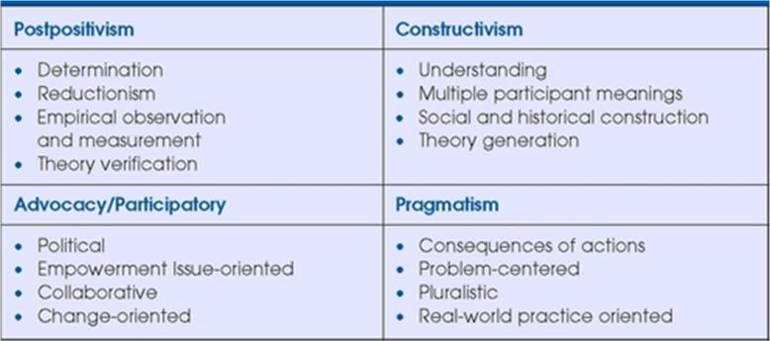
Four World Views

Slide 22
Strategies of Inquiry
These are types of qualitative, quantitative, and mixed methods designs or models that provide specific direction for procedures in a research design.
The strategies available have grown over the years as computer technology has pushed forward our data analysis and ability to analyse complex models and as individuals have articulated new procedures for conducting social science research.

Slide 23
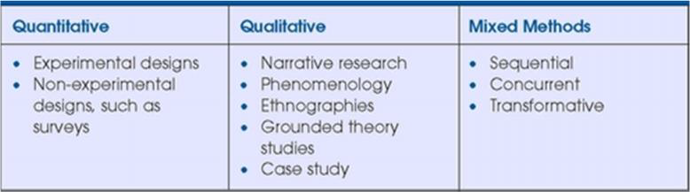
Alternative Strategies of Inquiry

Slide 24
Quantitative Strategies
In the 20th century it involves postpositivism worldview e.g. experiments, quasi-experiments and correlational studies.
recently, quantitative strategies have involved complex experiments with many variables and treatments
included elaborate structural equation models that incorporate causal paths and the identification of the collective strength of multiple variables. They include;
Survey research
Experimental research

Slide 25
Qualitative Strategies
There are many approaches and step by step procedures on specific qualitative methods of inquiry.
These include
Ethnography: studies an intact cultural group in a natural setting over a prolonged period of time by collecting, primarily, observational and interview data
Grounded theory:researcher derives a general, abstract theory of a process, action, or interaction grounded in the views of participants
Case studies

Slide 26
Qualitative Strategies…..
Phenomenological research: researcher identifies the essence of human experiences about a phenomenon as described by participants.
Narrative research: the researcher studies the lives of individuals and asks one or more individuals to provide stories about their lives.

Slide 27
Mixed Methods
It addressed limitations of a single method and decrease biasness.
Triangulating data sources—a means for seeking convergence across qualitative and quantitative method. These include;
Sequential mixed methods: researcher seeks to elaborate on or expand on the findings of one method with another method
Concurrent mixed methods: the researcher converges or merges quantitative and qualitative data in order to provide a comprehensive analysis of the research problem
Transformative mixed methods: uses a
theoretical lens (see Chapter 3) as an overarching perspective within a design that contains both quantitative and qualitative data

Slide 28
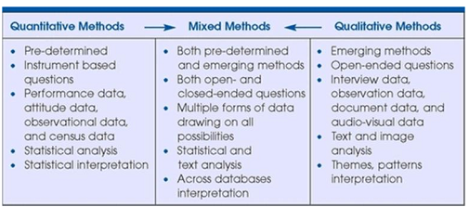
Research Methods
Research methods involves the forms of data collection, analysis, and interpretation that researchers propose for their studies..

Slide 29
Research Designs as worldview, strategies and Methods
The worldviews, the strategies, and the methods all contribute to a research design that tends to be quantitative, qualitative, or mixed.

Slide 30
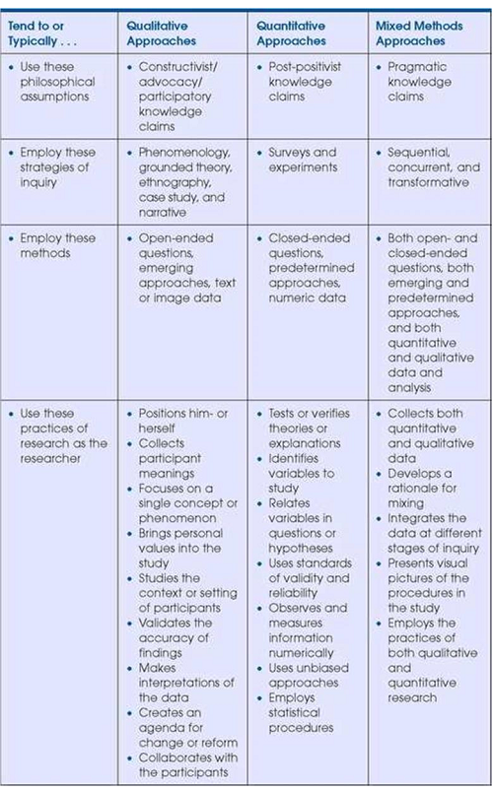

Slide 31
Criteria for selecting a research Design
The research problem
Personal experience
Audience

Slide 32



THANK YOU
Dr Jane Kuria
Telephone: +254-721 709511 Email: jane.kuria@dkut.ac.ke
D
Y
E
G
D
AN
O
IV T
L
K
IM
AT
HI
UN
ERSI
Y O
F T
EC
H
NO
Dedan Kimathi University of Technology

